Slide 1
Xamarin.Forms 5
Beutiful Apps with Less Code

Slide 2

Javier Suárez
Hi!. Mi name is Javier, I work in the Xamarin.Forms and .NET MAUI team at Microsoft. I love participating in technical communities and I am the coordinator of the SevillaDotNet and SVQXDG groups in Seville. You can contact me:
@jsuarezruiz
javiersuarezruiz@hotmail.com
https://javiersuarezruiz.wordpress.com

Slide 3
Xamarin.Forms 5

Slide 4

Do not hesitate to ask!

Slide 5
Why did you do this instead of that?
Notes:
The variety of customers we support
- UPS
Zaragosa Cty Council – discount app
Blueeye

Slide 6


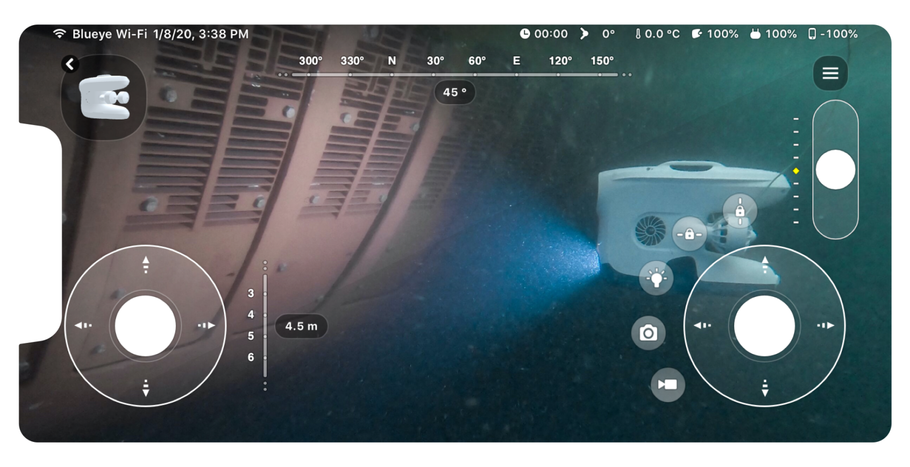
🤦‍♀️ Feedback Themes 🤦‍♂️
Stability
Feature completeness
Issue resolution
Remove experimental flags
Design
Gradients, shapes, templates
Productivity
Less platform code needed
Notes:
The variety of customers we support
- UPS
Zaragosa Cty Council – discount app
Blueeye

Slide 7
Last Year+ in Xamarin.Forms
Accessibility
BindableLayout EmptyView
Brushes (Solid & Gradient)
C# UI Extensions
CarouselView
Character Spacing
CheckBox
Drag and drop
EmbeddedFonts
Expander
FontImageSource
GIF Animations
HTML Label
IndicatorView
Maps+
MediaElement
Modal Prompts
Multi-Binding
RadioButton
RefreshView
RelativeSource Binding
Shapes, Paths, Clipping
Shell Modals
SourceLink
SwipeView
VisualStateManager Target
WKWebView
+ Much More!

Slide 8
“Experimental” in Xamarin.Forms
Accessibility
BindableLayout EmptyView
Brushes (Solid & Gradient)
C# UI Extensions
CarouselView
Character Spacing
CheckBox
Drag and drop
EmbeddedFonts
Expander
FontImageSource
GIF Animations
HTML Label
IndicatorView
Maps+
MediaElement
Modal Prompts
Multi-Binding
RadioButton
RefreshView
RelativeSource Binding
Shapes, Paths, Clipping
Shell Modals
SourceLink
SwipeView
VisualStateManager Target
WKWebView
+ Much More!

Slide 9
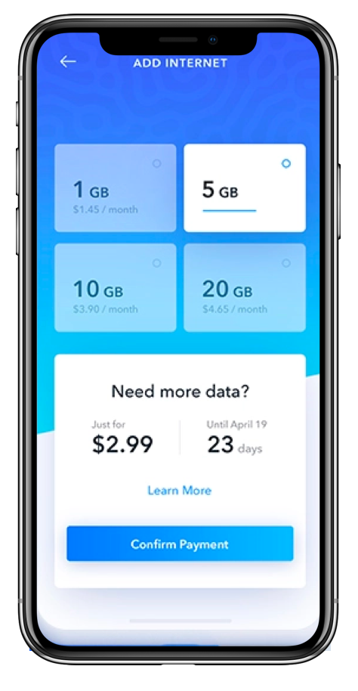
Brushes
<LinearGradientBrush
x:Key="HorizontalLinearGradient"
StartPoint="0, 0"
EndPoint="1, 0">
<LinearGradientBrush.GradientStops>
<GradientStop Color="#1C7EFF" Offset="0.1" />
<GradientStop Color="#3771F7" Offset="0.6" />
<GradientStop Color="#3877F6" Offset="1.0" />
</LinearGradientBrush.GradientStops>
</LinearGradientBrush>
<NavigationPage
BarBackground="{StaticResource HorizontalLinearGradient}">
</NavigationPage>

Slide 10

CarouselView
<CarouselView
ItemsSource="{Binding Burgers}"
HeightRequest="260"
HorizontalOptions="FillAndExpand"
CurrentItem="{Binding SelectedBurger}"
IsScrollAnimated="True"
IsSwipeEnabled="True">
<CarouselView.ItemTemplate>
<DataTemplate>
<t:BurgerItem />
</DataTemplate>
</CarouselView.ItemTemplate>
</CarouselView>
https://github.com/devcrux

Slide 11
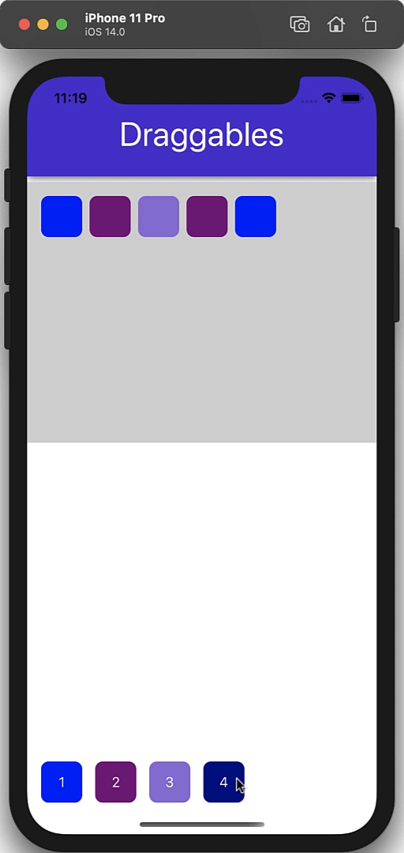
Drag and drop
<Button
Text="1"
BackgroundColor="Blue">
<Button.GestureRecognizers>
<DragGestureRecognizer
DragStarting="DragGestureRecognizer_DragStarting"
CanDrag="True" />
</Button.GestureRecognizers>
</Button>
<StackLayout>
<StackLayout.GestureRecognizers>
<DropGestureRecognizer AllowDrop="True"
DragOver="DropGestureRecognizer_DragOver"
DragLeave="DropGestureRecognizer_DragLeave"
Drop="DropGestureRecognizer_Drop"/>
</StackLayout.GestureRecognizers>
</StackLayout>

Slide 12
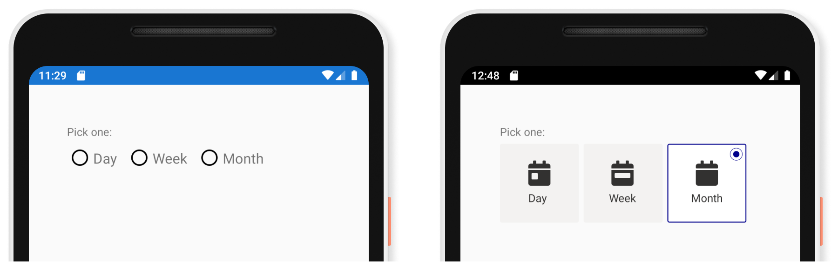
RadioButton
<StackLayout
RadioButtonGroup.GroupName="SimpleRadios"
Orientation="Horizontal">
<RadioButton Content="Day"/>
<RadioButton Content="Week"/>
<RadioButton Content="Month"/>
</StackLayout>
<RadioButton
ControlTemplate="{StaticResource
CalendarRadioTemplate}">
<RadioButton.Content>
<StackLayout
HorizontalOptions="Center"
VerticalOptions="Center">
<Image
Source="{FontImage FontFamily=FontAwesome,
Glyph={x:Static local:IconFont.CalendarDay},
Color=#323130,Size=32}"/>
<Label Text="Day" TextColor="#323130"/>
</StackLayout>
</RadioButton.Content>
</RadioButton>

Slide 13

Shapes & Paths
<!-- Lines and Dots -->
<Line X1="0" X2 ="300" Stroke="Pink"
StrokeThickness="2" StrokeDashArray="1,1"/>
<Ellipse HeightRequest="12" WidthRequest="360" Stroke="Pink" />
<!-- Conversation Bubble -->
<Grid Margin="12">
<BoxView
Grid.RowSpan="2"
Fill="{StaticResource AccentBrush}"/>
<Label Text="{Binding Text}">
<Label
Grid.Row="1"
Text="{Binding =Timestamp}"/>
<Path Grid.Row="2"
Data="m 0,0 l 16,0 l 0,16 l -16,-16"
Fill="{StaticResource AccentBrush}"
Margin="0,0,5,0" />
</Grid>

Slide 14
SwipeView
<SwipeView>
<SwipeView.LeftItems>
<SwipeItems>
<SwipeItem
BackgroundColor="#FFC107"
Invoked="OnFavoriteSwipeItemInvoked"
Text="Favorite" />
</SwipeItems>
</SwipeView.LeftItems>
<SwipeView.RightItems>
<SwipeItems>
<SwipeItem
BackgroundColor="#FF3D00"
Command="{Binding DeleteCommand}"
CommandParameter="{Binding}"
Text="Delete" />
</SwipeItems>
</SwipeView.RightItems>
<!-- Content -->
</SwipeView>
https://github.com/exendahal

Slide 15
“Experimental” in Xamarin.Forms
Accessibility
BindableLayout EmptyView
Brushes (Solid & Gradient)
C# UI Extensions
CarouselView
Character Spacing
CheckBox
Drag and drop
EmbeddedFonts
Expander
FontImageSource
GIF Animations
HTML Label
IndicatorView
Maps+
MediaElement
Modal Prompts
Multi-Binding
RadioButton
RefreshView
RelativeSource Binding
Shapes, Paths, Clipping
Shell Modals
SourceLink
SwipeView
VisualStateManager Target
WKWebView
+ Much More!

Slide 16
Xamarin Community Toolkit
Accessibility
BindableLayout EmptyView
Brushes (Solid & Gradient)
C# UI Extensions
CarouselView
Character Spacing
CheckBox
Drag and drop
EmbeddedFonts
Expander
FontImageSource
GIF Animations
HTML Label
IndicatorView
Maps+
MediaElement
Modal Prompts
Multi-Binding
RadioButton
RefreshView
RelativeSource Binding
Shapes, Paths, Clipping
Shell Modals
SourceLink
SwipeView
VisualStateManager Target
WKWebView
+ Much More!

Slide 17

Xamarin Community Toolkit
Behaviors
Animations
Validators
EventToCommand
ImpliedOrderGrid
Masked (input)
UserStoppedTyping
Extensions
ImageResource
Translate
ValueConverter
Helpers
Localization
Subscription
WeakEvent
Converters
ByteArrayToImageSource
ItemSelectedEventArgs
MultiConverterParameter
NotEqual
TextCase
MANY MORE!
ObjectModel
AsyncCommand
ObservableRangeCollection
Views
CameraView
Expander
RangeSlider
AvatarView
TabView
Effects
SafeArea
github.com/xamarin/xamarincommunitytoolkit

Slide 18

C# UI
Content = new Grid {
RowSpacing = 0,
RowDefinitions = Rows.Define(
(PageRow.Header, Auto),
(PageRow.Body , Star)
), Children = {
new ScrollView { Content = new StackLayout { Children = {
new Button { Text = nameof(RegistrationCodePage) }
.Style (FilledButton)
.FillExpandH ()
.Margin (PageMarginSize)
.Bind (nameof(vm.ContinueToRegistrationCommand)),
new Button { Text = nameof(NestedListPage) }
.Style (FilledButton)
.FillExpandH ()
.Margin (PageMarginSize)
.Bind (nameof(vm.ContinueToNestedListCommand)),
https://github.com/VincentH-Net

Slide 19
Expander
<xct:Expander
ExpandAnimationEasing="{x:Static Easing.Linear}"
CollapseAnimationEasing="{x:Static Easing.Linear}"
IsExpanded="{Binding IsDetailVisible, Mode=TwoWay}">
<xct:Expander.Header>
<v:HeaderView />
</xct:Expander.Header>
<!-- content -->
</xct:Expander>
https://github.com/jsuarezruiz

Slide 20
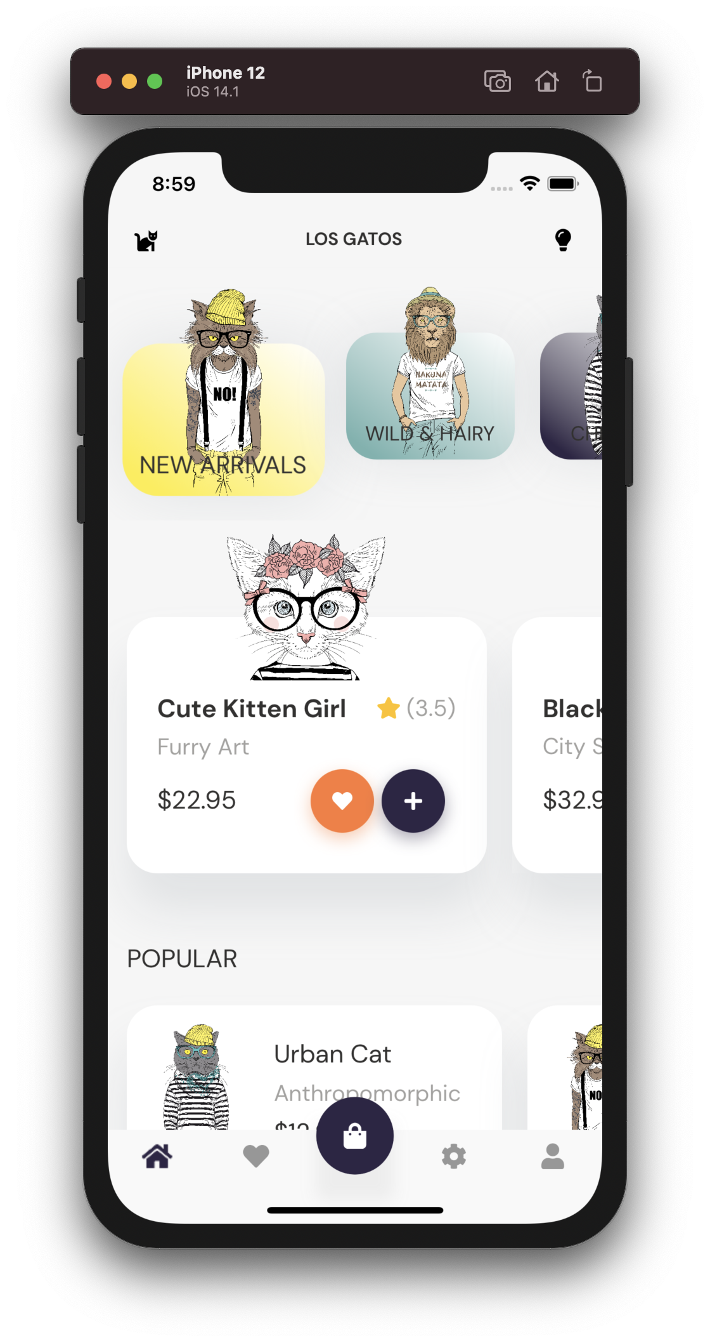
TabView
<xct:TabView
Style="{StaticResource CustomTabStyle}">
<xct:TabViewItem
ControlTemplate="{StaticResource FabTabItemTemplate}"
Style="{StaticResource TabItemStyle}"
Icon="{StaticResource PlusIcon}"
Command="{Binding AddCommand}"/>
<xct:TabViewItem
ControlTemplate="{StaticResource TabItemTemplate}"
Style="{StaticResource TabItemStyle}"
Icon="{StaticResource ClockIcon}"
ContentTemplate="{DataTemplate ClockView}"/>
<xct:TabViewItem
ControlTemplate="{StaticResource TabItemTemplate}"
Style="{StaticResource TabItemStyle}"
Icon="{StaticResource AlertIcon}"
ContentTemplate="{DataTemplate AlertView}"/>
<xct:TabViewItem
ControlTemplate="{StaticResource TabItemTemplate}"
Style="{StaticResource TabItemStyle}"
Icon="{StaticResource SettingsIcon}"
ContentTemplate="{DataTemplate SettingsView}"/>
</xct:TabView>

Slide 21
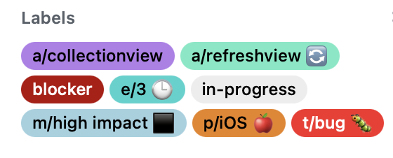
Xamarin.Forms 5.0.x
Stability
Issue resolution
Performance
Memory leaks, etc
Notes:
The variety of customers we support
- UPS
Zaragosa Cty Council – discount app
Blueeye

Slide 22
Questions?

